Slide 1
Steering Angle Prediction For Self Driving Car Using Convolutional Network

Slide 2
Group Members:
Sahil Makandar
Shyam Patel
Shubham Patni
Gourav Bhosale
Hrishikesh Shinde
Faisal Momin

Slide 3
Index
Problem Description
Introduction
I/O
System Architecture
Methodology

Slide 4
Problem Description
Transportation system today is not much secure & efficient.
Most of the accidents occurs due to human errors and negligence.

Slide 5
Introduction
Steering angle prediction module for a self driving car.
Designed and trained using convolutional neural network.
Works with minimum human intervention.
Major Companies (Google, Uber etc.) doing research in this field.

Slide 6
I/O
Input
Output
Video Frames recorded by dash camera.
Visualization with Predicted Steering Angle.

Slide 7
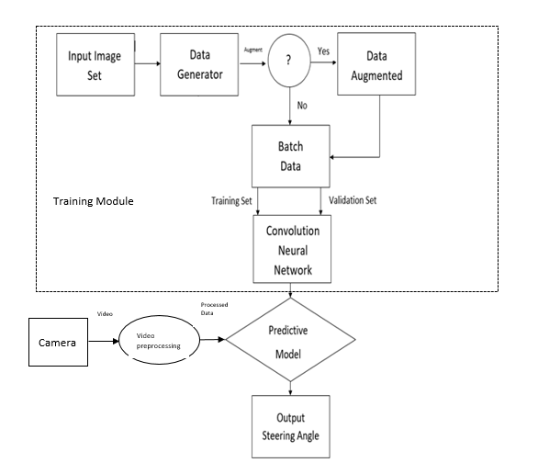
System Architecture

Slide 8
Methodology
Input Module :
reads image from input dataset
reads two separate CSV files (camera.csv, steering.csv)
splits dataset into testing set & validation set
Data Generator :
generates various computational specific parameters viz. Timestamp, ranges, shuffle, etc.
Passes 1 of every 3 images for data augmentation

Slide 9
Methodology
Data Augmenter:
- Performs augmentation processes
Augmented images are added to current image set & their corresponding steering angles are also adjusted.
4. Convolutional Neural Network:
- core processing module of system
trained against the training set, received from data generator & weight adjustments are performed by validation set
predict model is generator

Slide 10
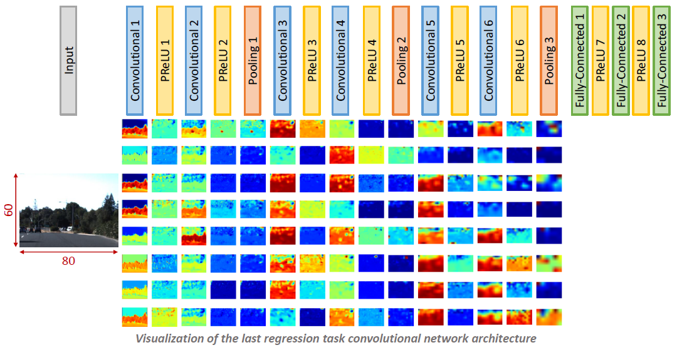
CNN Architecture

Slide 11
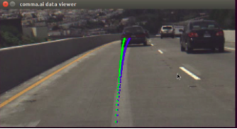
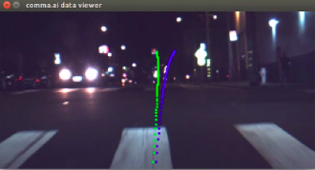
Methodology
Output Module module:
- Visualises the predicted steering angle for each frame

Slide 12
Thank You!

